Slide 1
IVR Health
Centers of Excellence
July 2019

Slide 2
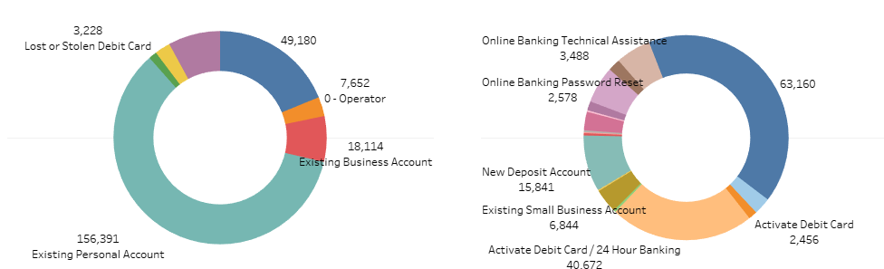
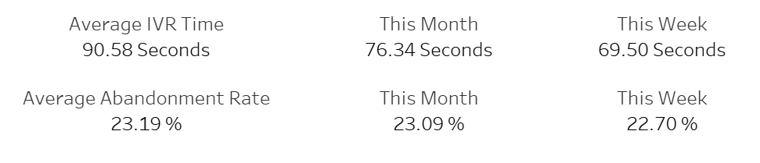
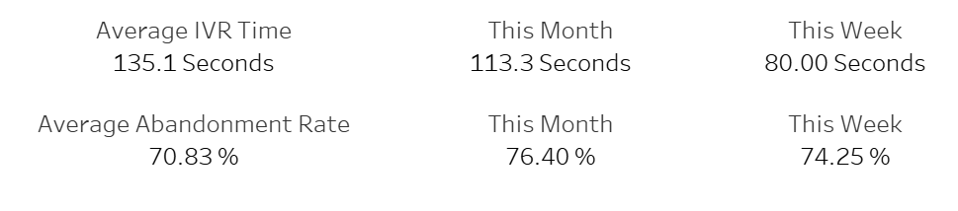
User Experience (UX) Problems
The Average IVR Experience
Invalid Options (including 0)

Slide 3
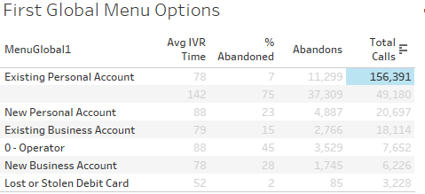
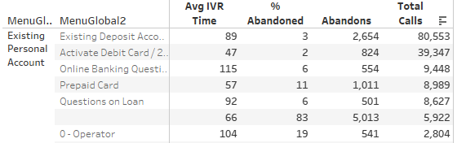
UX Solutions: Average IVR Experience
Reorder IVR menus by call volume/traffic.

Slide 4

UX Solutions: Invalid Options
15% of callers are not routed directly and decide to abandon. Not causal.
INBOUND CALL
ExPersonal
Main Menu
User Inputs an Invalid Option
User Inputs an Invalid Option
Count = 2
Key
Frustration Area
Solution
No issue
If Count > 1
Operator
If Count > 1
Operator
OPERATOR
Count = 2

Slide 5
Reporting Problems
Caller experience data is ambiguous; we must enrich our data by implementing new modules.
Origin
(Campaign)
Key
Undocumented
Solution
Documented
Did the caller get lost?
Retraces
How intuitive is the IVR?
IVR Changes
Where did the caller go?
Last menu
Menu of Abandon [frustration] or Menu of Transfer [purpose for the call]

Slide 6


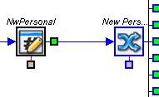
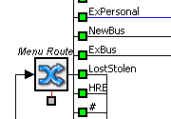
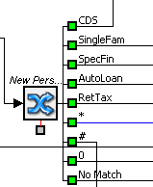



Reporting Solutions
Add modules at menu-to-menu and menu-to-script junctions.
Last Menu
Menu_Choices.Global_First_Menu
Global_Last_Menu
Global_Last_Menu
“Existing Personal Account”
Retraces
retraces
SUM(retraces,1)
Retraces

Slide 7
Conclusion
3 Key takeaways:
Create 2 new variables
The relationship between last menu and retraces illustrates which functions are difficult to perform/find in the IVR
Directly route users who press an invalid number 2 times, do not route them to ExPersonal
Reorder menu options by call volume to improve average IVR time

